Slide 1
Compiler Construction
COMP 7.1
Unit 4

Slide 2

Course Outcomes
Course Outcome No. | CO Description | Cognitive Level
COMP 7.1.1 | Define the components and phases of the compiler, and the types of parsers. | CL1
COMP 7.1.2 | Explain the components and phases of the compiler. | CL2
COMP 7.1.3 | Apply algorithms to design a lexical analyser, construct a parser by hand, generate intermediate code and target code. | CL3
COMP 7.1.4 | Write a LEX/YACC specification for a given Regular Expression and CFG and use the LEX/YACC tool. | CL3
Compiler Construction

Slide 3
Unit 4 Syllabus
Code generation Questions
Code optimization Questions
Basic blocks and flow graphs,
Next-use information,
A simple Code generator,
The principal sources of optimization,
Optimization of basic blocks,
The DAG representation of Basic blocks,
Peephole Optimization,
Machine dependent optimization,
Issues in the design of a code Generator,
Generating code from DAGS.
Register allocation optimization.

Slide 4
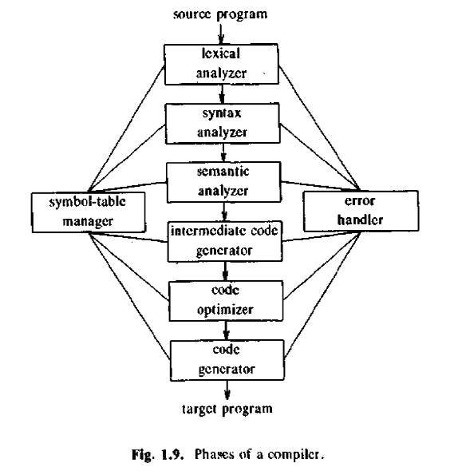
Unit 4

Slide 5
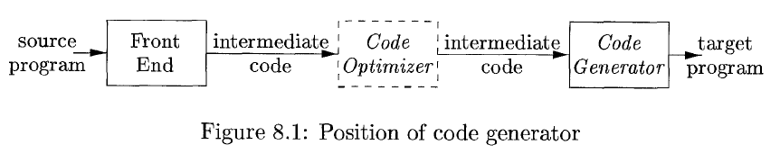
Chapter 9: Code Generation
Final phase in the compiler model
Input – intermediate representation of the source program
Output – an equivalent target program

Slide 6
Requirements on a code generator:
Output code must be correct
Output code must be of high quality, i.e.,
it should make effective use of the resources of the target machine
3. Code generator itself should run efficiently

Slide 7
9.1 Issues in the design of a code Generator
Input to the Code Generator
Target Programs
Memory Management
Instruction Selection
Register Allocation
Choice of Evaluation order
Approaches to Code Generation

Slide 8

Input to the code generator
Input consists of:
the intermediate representation of the source program
the information in the symbol table – to determine the run-time addresses of the data objects denoted by names in the intermediate representation
Choices for the intermediate language are:
Linear representation such as postfix notation
Three-address representations such as quadruples
Virtual machine representations such as stack machine code
Graphical representations such as syntax trees and dags

Slide 9

Target program
Is the output of the code generator
The output may take on a variety of forms:
Absolute machine language –
advantages - can be placed in a fixed location in memory
can be immediately executed.
A small program can be compiled and executed quickly
Relocatable machine language (object module) –
allows sub-programs to be compiled separately.
A set of relocatable object modules can be linked together and loaded for execution by a linking loader.
At the expense of linking and loaded we gain:
flexibility in being able to compile sub-routines separately and
to call other previously compiled programs from an object module.
The compiler must provide relocation information in case the target machine does not handle relocation automatically.
3. Assembly language –
makes code generation easier.
We can generate symbolic instructions and
use the macro facilities of the assembler to help generate code

Slide 10

Memory management
Mapping names in the source program to addresses of data objects in run-time memory is done co-operatively by the front end and the code generator.
The type in a declaration statement determines the width, i.e., the amount of storage needed for the declared name.
From the symbol-table information, a relative address can be determined for the name in a data area for the procedure
If machine code is generated, labels in 3-address statements have to be converted to address of instructions

Slide 11

Instruction selection
The nature of the instruction set of the target machine determines the difficulty of instruction selection
The uniformity and completeness of the instruction set are important factors
If the target machine does not support each data type in a uniform manner, then each exception to the general rule requires special handling.
A target machine with a rich instruction set may provide several ways of implementing a given operation
the cost differences between different implementations may be significant

Slide 12

Register Allocation
Instructions involving register operands are usually shorter and faster than those involving operands in memory
Efficient utilization of registers is particularly important in generating good code
The use of registers is often sub-divided into two sub-problems:
During register allocation, select the set of variables that will reside in registers at a point in the program
During a subsequent register assignment phase, pick the specific register that a variable will reside in
Finding an optimal assignment of registers to variables is difficult, even with single-register values

Slide 13


Choice of evaluation order
The order in which computations are performed can affect the efficiency of the target code
Some computation sequences require fewer registers to hold intermediate results than others
Approaches to code generation
Designing a code generator so that it can be easily implemented, tested, and maintained is an important design goal.
Peephole optimization techniques
Allocating registers for heavily used operands in inner loops
Tree-directed code-selection techniques

Slide 14
9.4 Basic blocks and flow graphs
A graph representation of 3-address statements is called a flow graph
Nodes in the flow graph represent computations and the edges represent the flow of control
A basic block is a sequence of consecutive statements in which flow of control enters at the beginning and leaves at the end without halt or possibility of branching except at the end
A name in a basic block is said to be ‘live’ at a given point if its value is used after that point in the program perhaps in another basic block

Slide 15
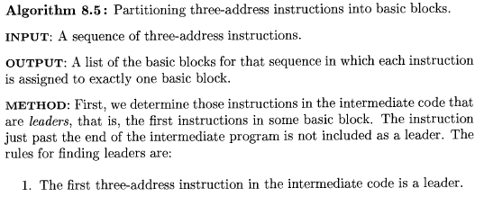
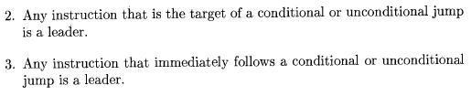

Slide 16
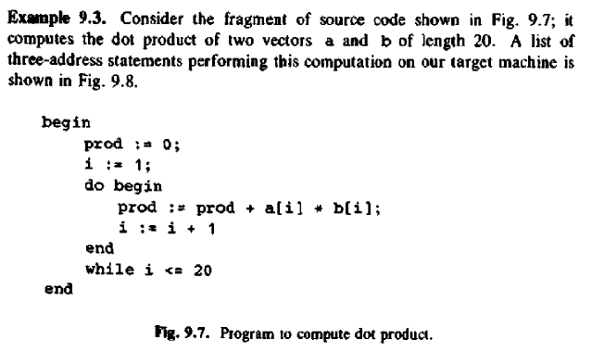

Slide 17
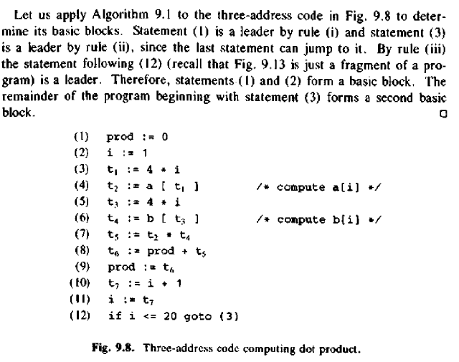
Leader
Leader
Leader

Slide 18
Transformations on basic blocks
A basic block computes a set of expressions
These expressions are the values of the names live on exit from the block
Equivalent basic blocks - compute the same set of expressions
A number of transformations can be applied to a basic block without changing the set of expressions computed by the block
Many of these transformations are useful for improving the quality of code that will ultimately be generated from a basic block
There are 2 important classes of local transformations that can be applied to basic blocks:
Structure-preserving transformations
Algebraic transformations

Slide 19
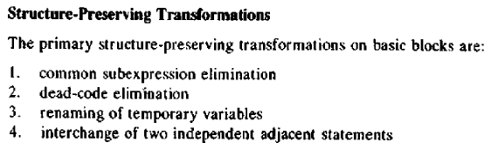

Slide 20
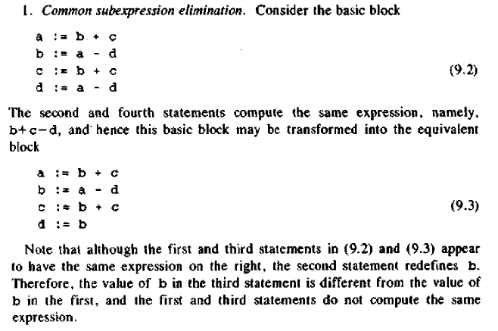

Slide 21
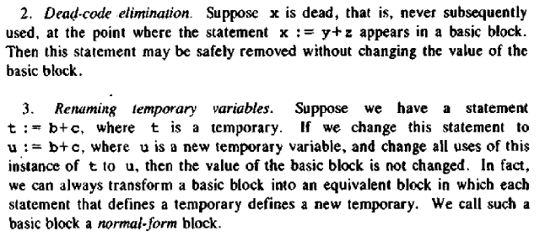

Slide 22
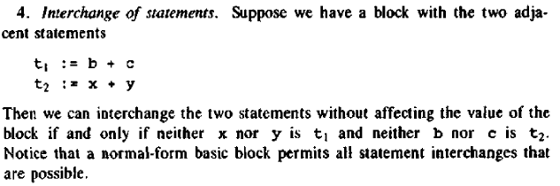

Slide 23
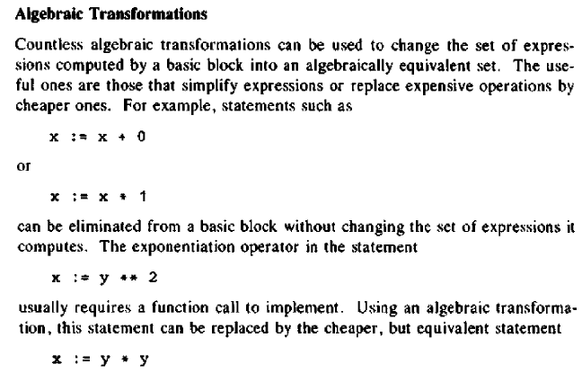

Slide 24
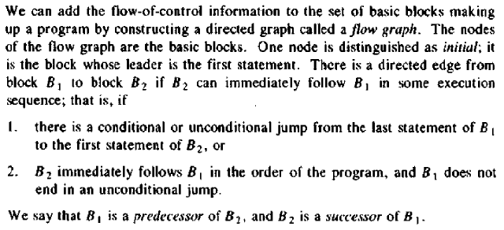
Flow graphs

Slide 25
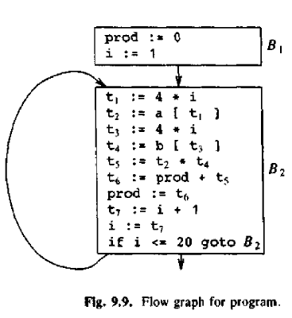

Slide 26
9.5 Next-use information
Is collected about names
If the name in a register is no longer needed, then the register can be assigned to some other name
The name is kept in storage only if it will be used subsequently

Slide 27
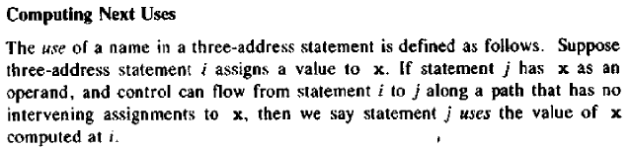
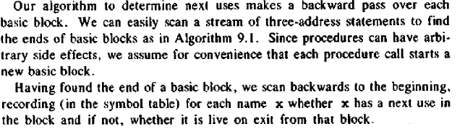
x = 12
Control flow
j) a = x+3

Slide 28
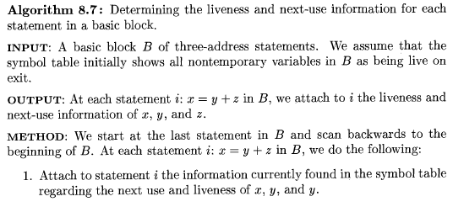
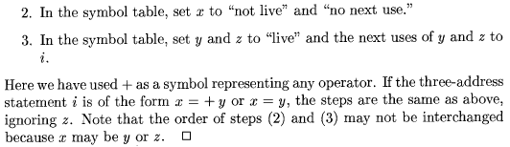

Slide 29
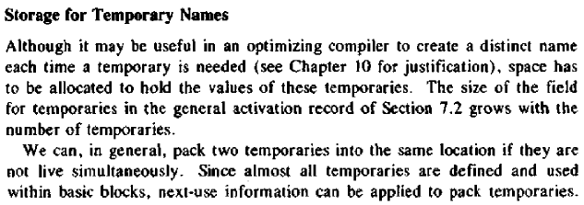

Slide 30
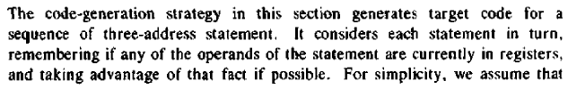
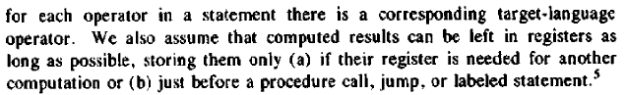
9.6 A simple Code generator

Slide 31
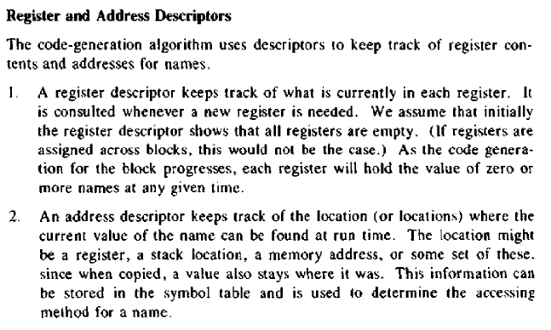

Slide 32
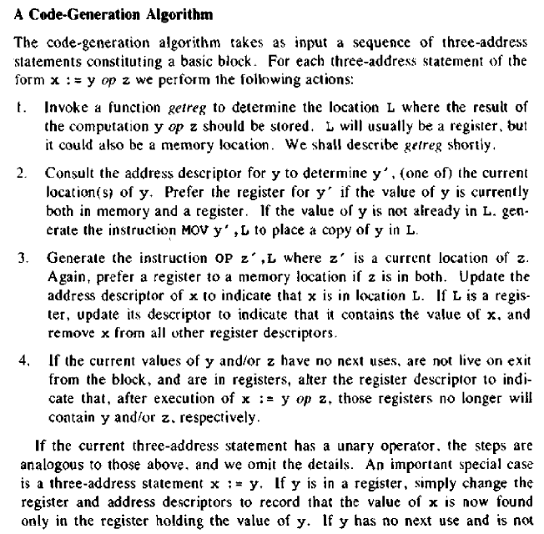

Slide 33
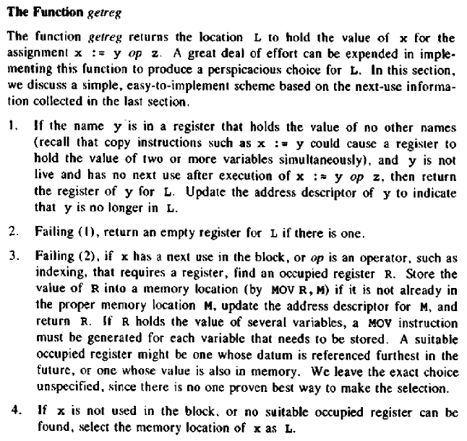

Slide 34
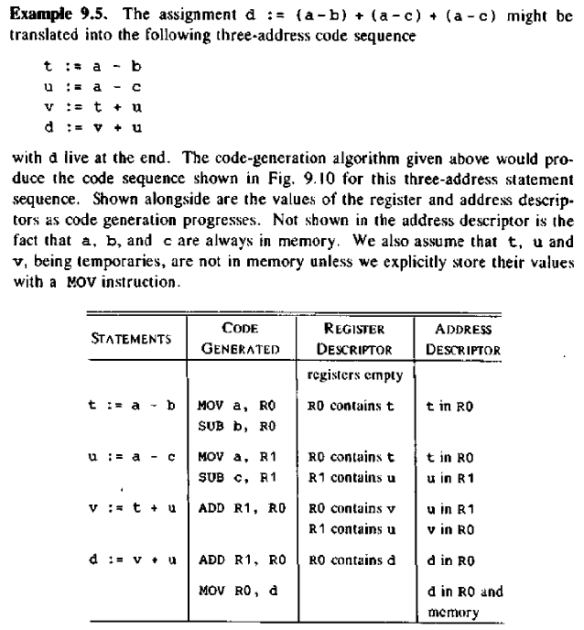
(1)
(2)
(3)
(4)
Next use of t in (3); Next Use of a, b is (1)
Next use of u in (3); Next Use of a, c is (2)
Next use of v in (4); Next uses of t, u is (3)
D is live on exit; v, u are used in (4)

Slide 35
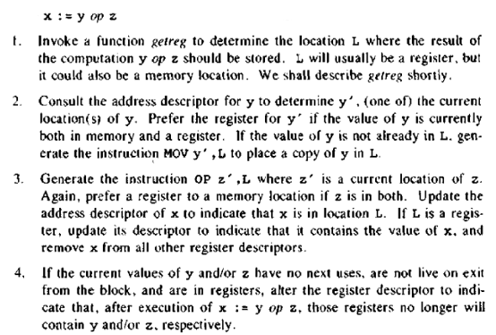
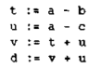
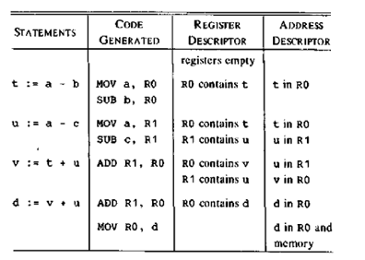

Slide 36
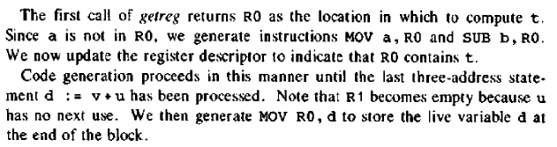

Slide 37
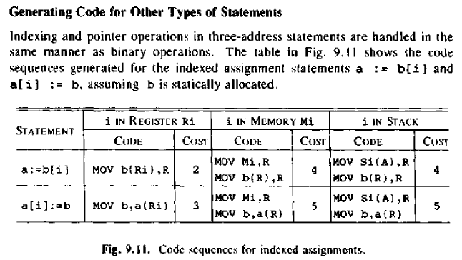

Slide 38
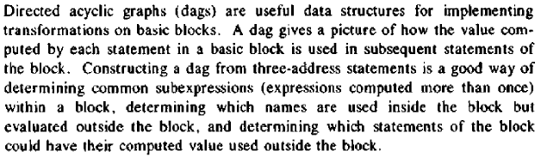
9.8 The DAG representation of Basic blocks

Slide 39
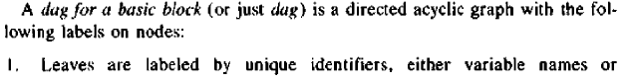
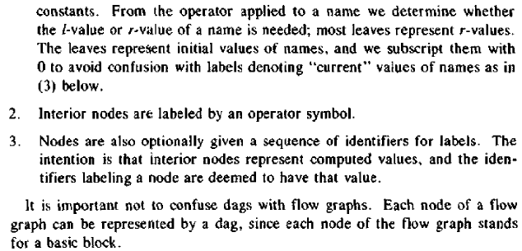

Slide 40
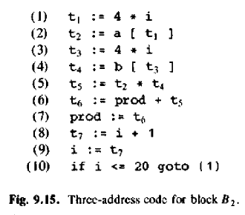
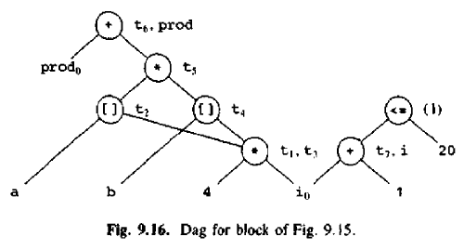

Slide 41
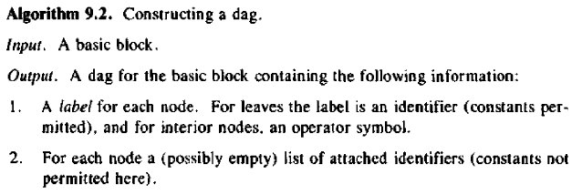
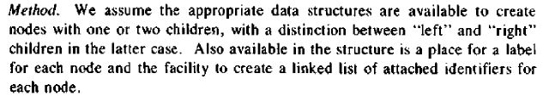
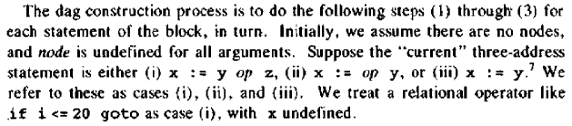

Slide 42
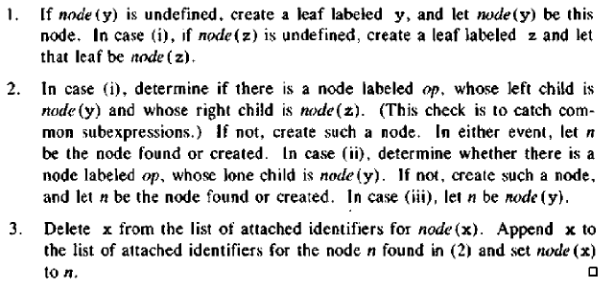

Slide 43
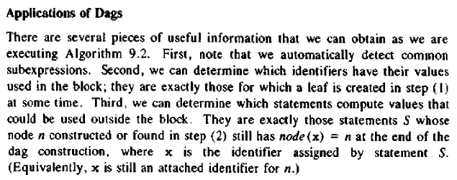
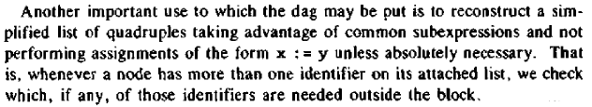

Slide 44
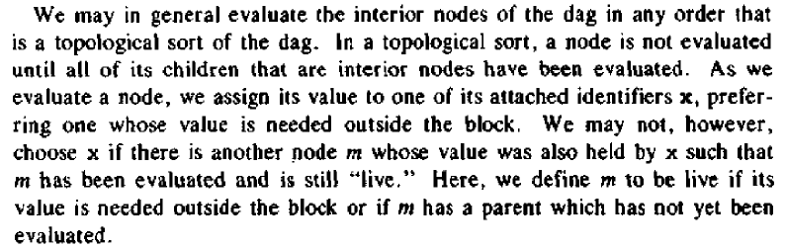

Slide 45
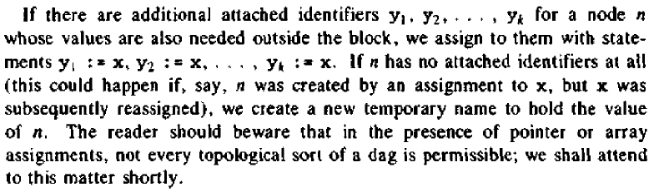

Slide 46
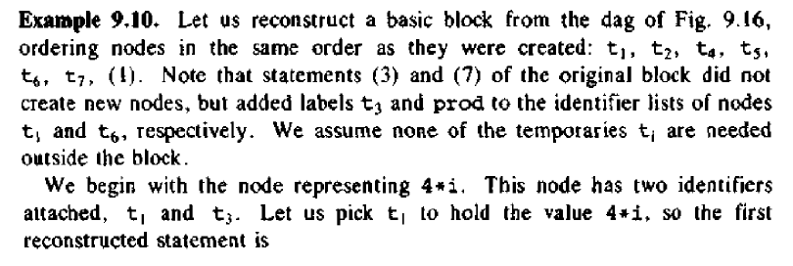

Slide 47
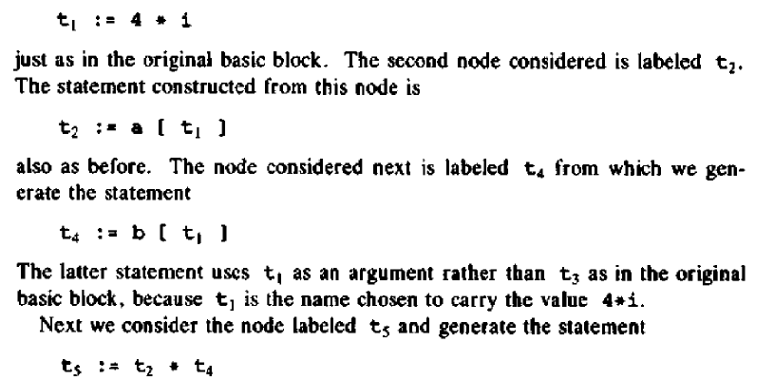

Slide 48
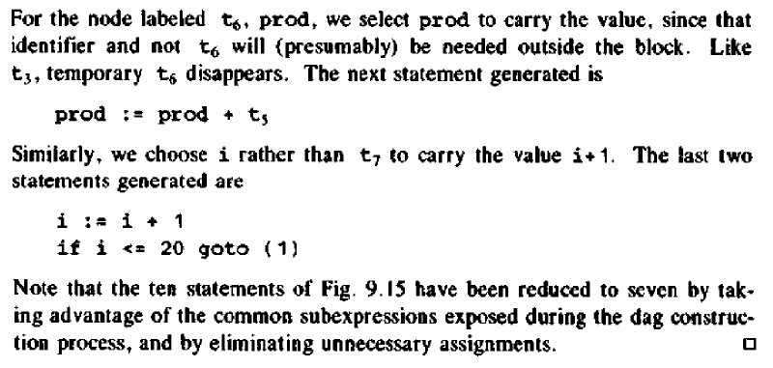

Slide 49
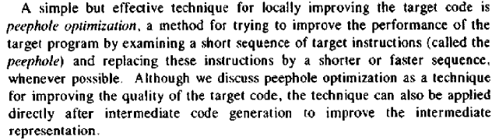
9.9 Peephole Optimization

Slide 50
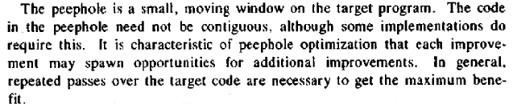
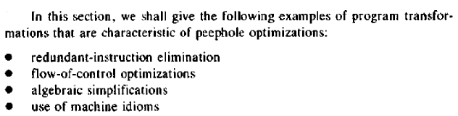

Slide 51
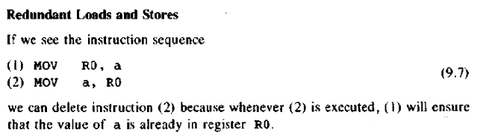

Slide 52
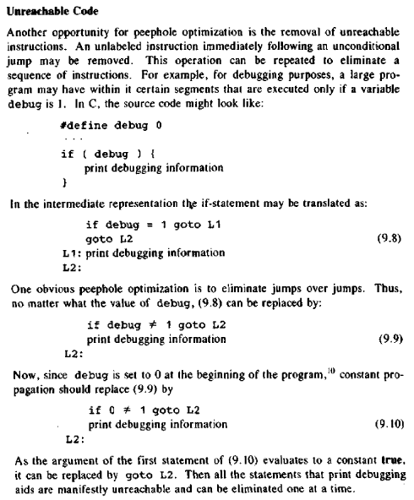

Slide 53


Slide 54


Slide 55


Slide 56


Slide 57


Slide 58


9.10 Generating code from DAGS

Slide 59


Slide 60


Slide 61


Slide 62


Slide 63





Slide 64


Slide 65


Slide 66





Slide 67


Questions

Slide 68



Slide 69



Slide 70
Questions
The End
of
Code generation

Slide 71
Chapter 10: Code Optimization
Compilers that apply code-improving transformations are called optimizing compilers
The most payoff for the least effort is obtained if we can identify the frequently executed parts of a program and then make these parts as efficient as possible
It is often the case that a small fraction of a program accounts for most of the running time
Profiling the run-time execution of a program on representative input data accurately identifies the heavily travelled regions of a program
In practice, a program’s inner loops are good candidates for improvement.
Criteria for code-improving transformations:
Preserve the meaning of programs
Speed up programs
Be worth the effort

Slide 72


Slide 73


Slide 74


Slide 75


Slide 76


Slide 77
10.2 The principal sources of optimization
A transformation of a program that can be performed by looking only at the statements in a basic block (local)
Function-preserving transformations
Ways in which a compiler can improve a program without changing the function it computes
Common-subexpression elimination
Copy propagation
Dead-code elimination
Constant folding

Slide 78



Slide 79




Slide 80


Slide 81


Slide 82


Slide 83


Slide 84



Slide 85
Loop Optimizations
Programs tend to spend the bulk of their time in inner loops
The running time of a program may be improved if we decrease the number of instructions in an inner loop, even if we increase the amount of code outside that loop
Techniques:
Code motion
Induction-variable elimination
Reduction in strength
Loop unrolling
Loop jamming

Slide 86


Slide 87


Slide 88

Let j =3
t4 = 12
j =2
t4 =12- 4=8
Let j =3
j =2
t4 = 8

Slide 89


Slide 90


Slide 91


Slide 92


Slide 93


Slide 94

10.3 Optimization of basic blocks
Many of the structure-preserving transformations can be implemented by constructing a dag for a basic block

Slide 95



Slide 96


Slide 97


Slide 98
Machine dependent optimization
The goals of optimization are the reduction of execution time and the improvement in memory usage
The target machine and the source language heavily influence the nature of a Machine Dependent Optimization
Concerned with the realization of an algorithm on a particular piece of hardware
Examples
Register allocation
Special machine features
Data intermixed with instruction
Peephole optimization
Special instructions
Code rearrangement

Slide 99
Register allocation optimization
Key step for speeding up the execution of the resulting code and for deriving positive gain out of other optimization steps
The life time analysis of variables is done and the problem of identifying minimum number of registers is modelled as a graph colouring problem
The graph is formed with the variables as nodes and an arc between a pair of nodes exists if their life-time overlaps
The minimum number of colours necessary to properly colour this graph specifies the minimum number of registers necessary to store the variables
The emphasis is to ensure 100% allocation of active variables by allocating sufficient number of registers

Slide 101
Questions
The End
of
Code optimization

